Slide 1
MODULE-1 AWS Basics

Slide 2
Lesson 1
Traditional Infrastructure Topology vs. AWS

Slide 3
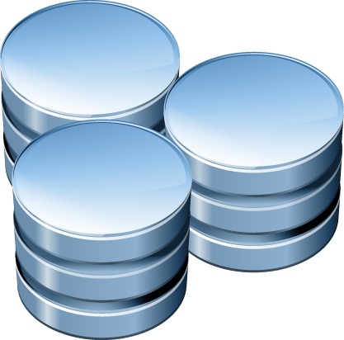
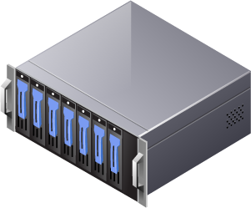
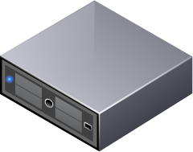
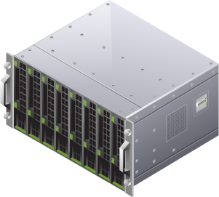
Traditional Infrastructure Topology
Core
Distribution
Access
Notes:
The classic network design for most customers and businesses would focus on the 3-Tiered approach of Access, Distribution and Core Layers
Access Layer- The point of entry for a user of the network. A user can be loosely defined as an endpoint that possess an IP address and/or MAC address. In the case of the example, it would be the servers, storage clusters or hosts that require access to network and will do so through an access switch. This switch is normally stored in a rack or closet where all of the wiring from the offices comes back to.
Distribution Layer- Policy is introduced here for control and isolation. Policy is another term in networking that refers to the process in which you want to handle a particular conversation. You can dictate how and where the traffic flow is permitted to go and under what conditions. The Distribution device is also used to collapse all of the access devices into fewer devices to improve the price per port that was originally intended on the switch.
Core Layer- This focus of this layer is to forward packets as quickly as possible with as little interference as possible. Like the Distribution device, a Core device will help consolidate a higher number of Distribution devices.

Slide 4
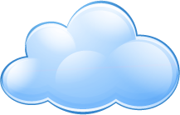


Interconnecting Infrastructure for Resiliency
WAN/LAN
Notes:
When managing a hosted infrastructure, capital and resources will need to provided (with scalability in mind) in the following areas:
Equipment
Hosting (rack-space and power)
Manpower to support the infrastructure
Networking between each site and to the internet

Slide 5
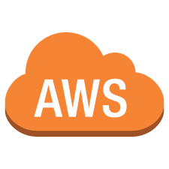
Network Topology Utilizing AWS
WAN
Services
Notes:
When utilizing the AWS infrastructure, you have the ability to leverage limitless resources and services to produce fully customized, scalable and resilient environment. No more need to prepare for future elasticity of your business needs when managing your Infrastructure environment.

Slide 6
Lesson 2
AWS Infrastructure Overview

Slide 7
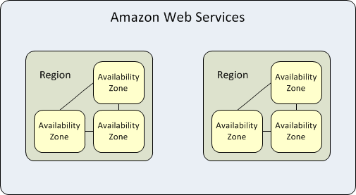
Regions and Availability Zones
Amazon EC2 resources are either global, tied to a region, or tied to an Availability Zone
Each Amazon EC2 region is designed to be completely isolated from the other Amazon EC2 regions
Each Availability Zone is isolated, but the Availability Zones in a region are connected through low-latency links
Notes:
The AWS Cloud infrastructure is built around Regions and Availability Zones (“AZs”). A Region is a physical location in the world where we have multiple Availability Zones. Availability Zones consist of one or more discrete data centers, each with redundant power, networking and connectivity, housed in separate facilities. These Availability Zones offer you the ability to operate production applications and databases which are more highly available, fault tolerant and scalable than would be possible from a single data center.
Unlike virtually every other technology infrastructure provider, each AWS Region has multiple Availability Zones and data centers. Availability Zones are distinct locations that are engineered to be isolated from failures in other Availability Zones. By launching instances in separate Availability Zones, you can protect your applications from the failure of a single location.
Customers who care about the availability and performance of their applications want to deploy these applications across multiple Availability Zones in the same region for fault tolerance and low latency. Availability Zones are connected to each other with fast, private fiber-optic networking, enabling you to easily architect applications that automatically fail-over between Availability Zones without interruption.

Slide 8
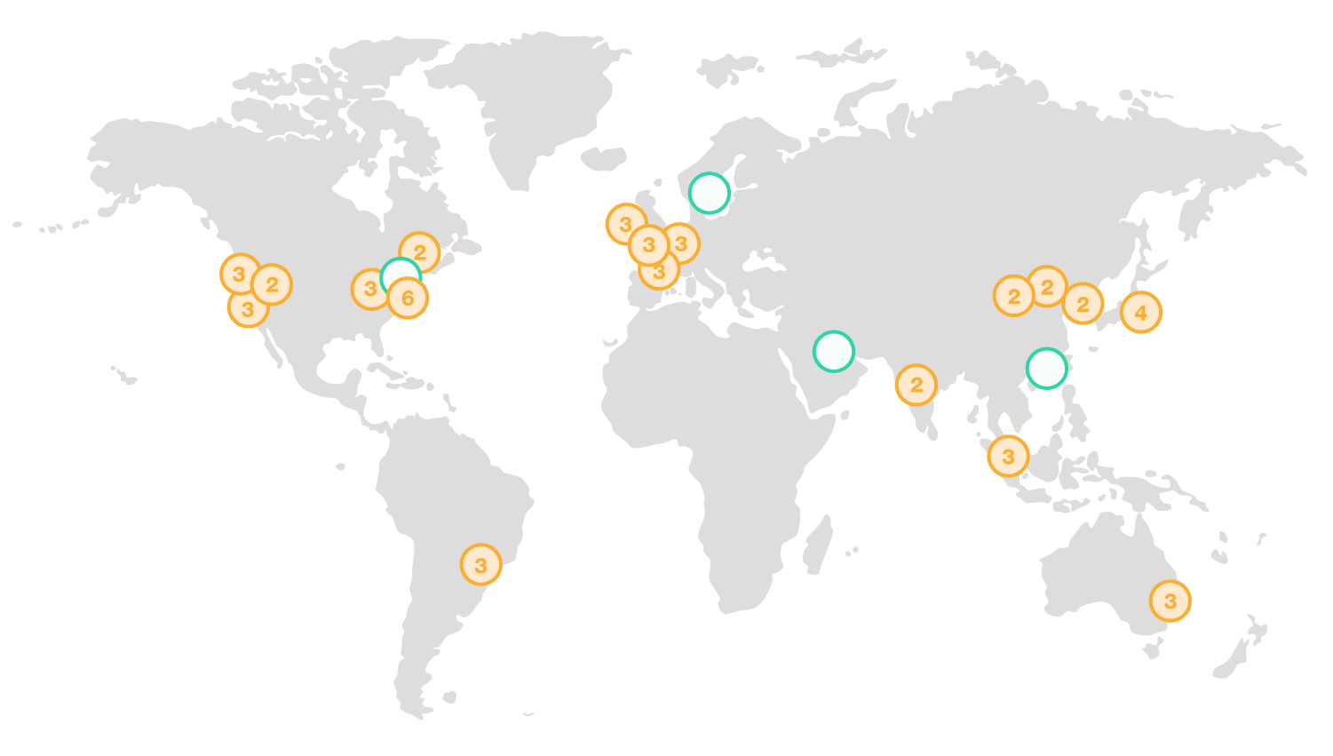
Current AWS Regions
Notes:
The AWS Cloud spans 52 Availability Zones within 18 geographic Regions around the world. (as of 2018-02)

Slide 9
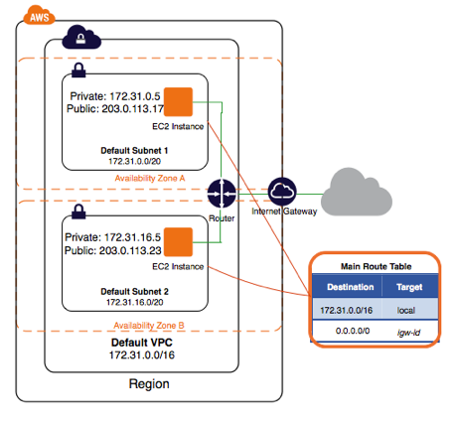
What is a VPC?
Notes:
Amazon Virtual Private Cloud (Amazon VPC) enables you to launch Amazon Web Services (AWS) resources into a virtual network that you've defined. This virtual network closely resembles a traditional network that you'd operate in your own data center, with the benefits of using the scalable infrastructure of AWS.

Slide 10

VPC
Virtual network dedicated to your AWS account
Logically isolated from other virtual networks in the AWS cloud
You launch your AWS resources, such as Amazon EC2 instances in the VPC
You can configure the following within your VPC:
IP Range
Subnets
Route Tables
Network Gateways
Security Settings
Notes:
Amazon VPC is the networking layer for Amazon EC2.
A virtual private cloud (VPC) is a virtual network dedicated to your AWS account. It is logically isolated from other virtual networks in the AWS cloud. You can launch your AWS resources, such as Amazon EC2 instances, into your VPC. When you create a VPC, you specify the set of IP addresses for the VPC in the form of a Classless Inter-Domain Routing (CIDR) block (for example, 10.0.0.0/16).

Slide 11
Subnet
A subnet is a range of IP addresses in your VPC
You can launch AWS resources into a subnet that you select
Use a public subnet for resources that must be connected to the Internet
Use a a private subnet for resources that won't be connected to the Internet
Notes:
You can create a VPC that spans multiple Availability Zones. After creating a VPC, you can add one or more subnets in each Availability Zone. Each subnet must reside entirely within one Availability Zone and cannot span zones. AWS assigns a unique ID to each subnet.

Slide 12

Route Table
A route table contains a set of rules, called routes, that are used to determine where network traffic is directed
Each subnet in your VPC must be associated with a route table
The table controls the routing for the subnet
A subnet can only be associated with one route table at a time, but you can associate multiple subnets with the same route table.
Notes:
A route table contains a set of rules, called routes, that are used to determine where network traffic is directed.
Each subnet in your VPC must be associated with a route table; the table controls the routing for the subnet. A subnet can only be associated with one route table at a time, but you can associate multiple subnets with the same route table.

Slide 13


Internet Gateway and Virtual Private Gateway
An Internet gateway (IGW) is a horizontally scaled, redundant, and highly available VPC component that allows communication between instances in your VPC and the Internet
IGWs provide a target in your VPC route tables for Internet-routable traffic
IGWs perform network address translation (NAT) for instances that have been assigned public IP addresses
Virtual Private Gateways (VGW) are connectors on the VPC side of a VPN Connection, VPC Peering and Virtual Interface
Notes:
An Internet gateway is a horizontally scaled, redundant, and highly available VPC component that allows communication between instances in your VPC and the Internet. It therefore imposes no availability risks or bandwidth constraints on your network traffic.
An Internet gateway serves two purposes: to provide a target in your VPC route tables for Internet-routable traffic, and to perform network address translation (NAT) for instances that have been assigned public IP addresses.
By default, instances that you launch into a virtual private cloud (VPC) can't communicate with your own network. You can enable access to your network from your VPC by attaching a virtual private gateway to the VPC, creating a custom route table, and updating your security group rules.

Slide 14
Lesson 3
Creating the VPC via
Management Console

Slide 15
Lesson 3
Directed Activity – Building a VPC

Slide 16
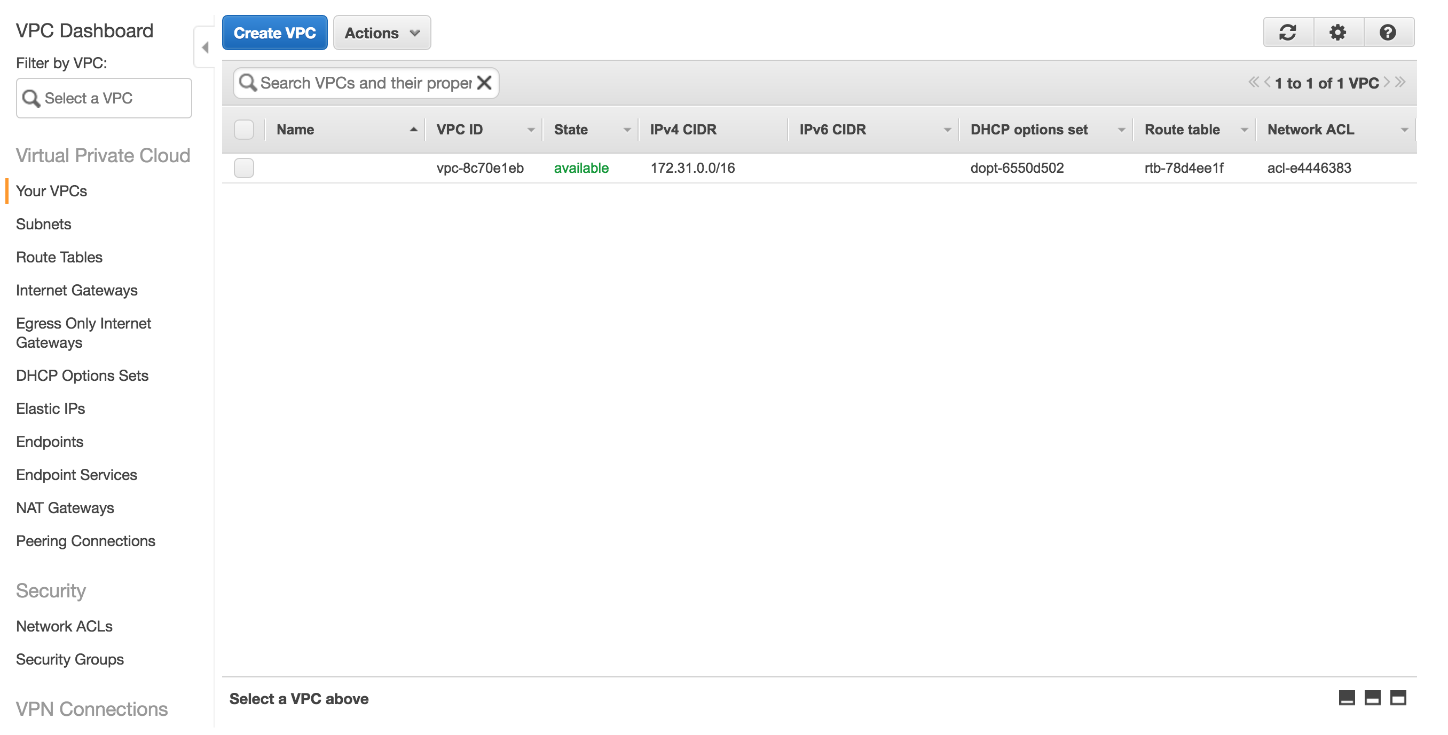
Creating a VPC
Notes:
An Amazon Virtual Private Cloud (VPC) is where we will build a virtual network. Much like a traditional on premise infrastructure, the VPC service will contain tools necessary establish a resilient, feature rich and secure network infrastructure. The following steps will establish the networking necessary to effectively operate your cloud infrastructure.

Slide 17
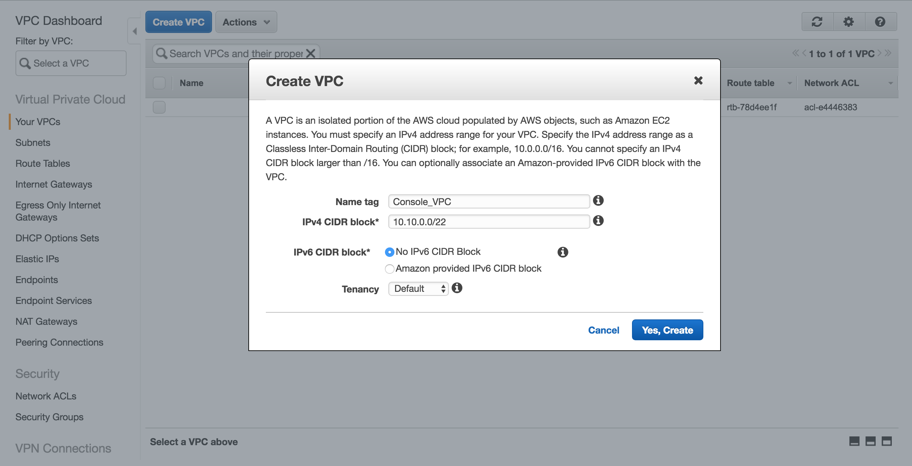
Creating a VPC Cont’d
Notes:
Within the Create VPC window, configure your new VPC with the necessary name tag and CIDR block. Once configured, select the ‘Yes, Create’ Button.

Slide 18
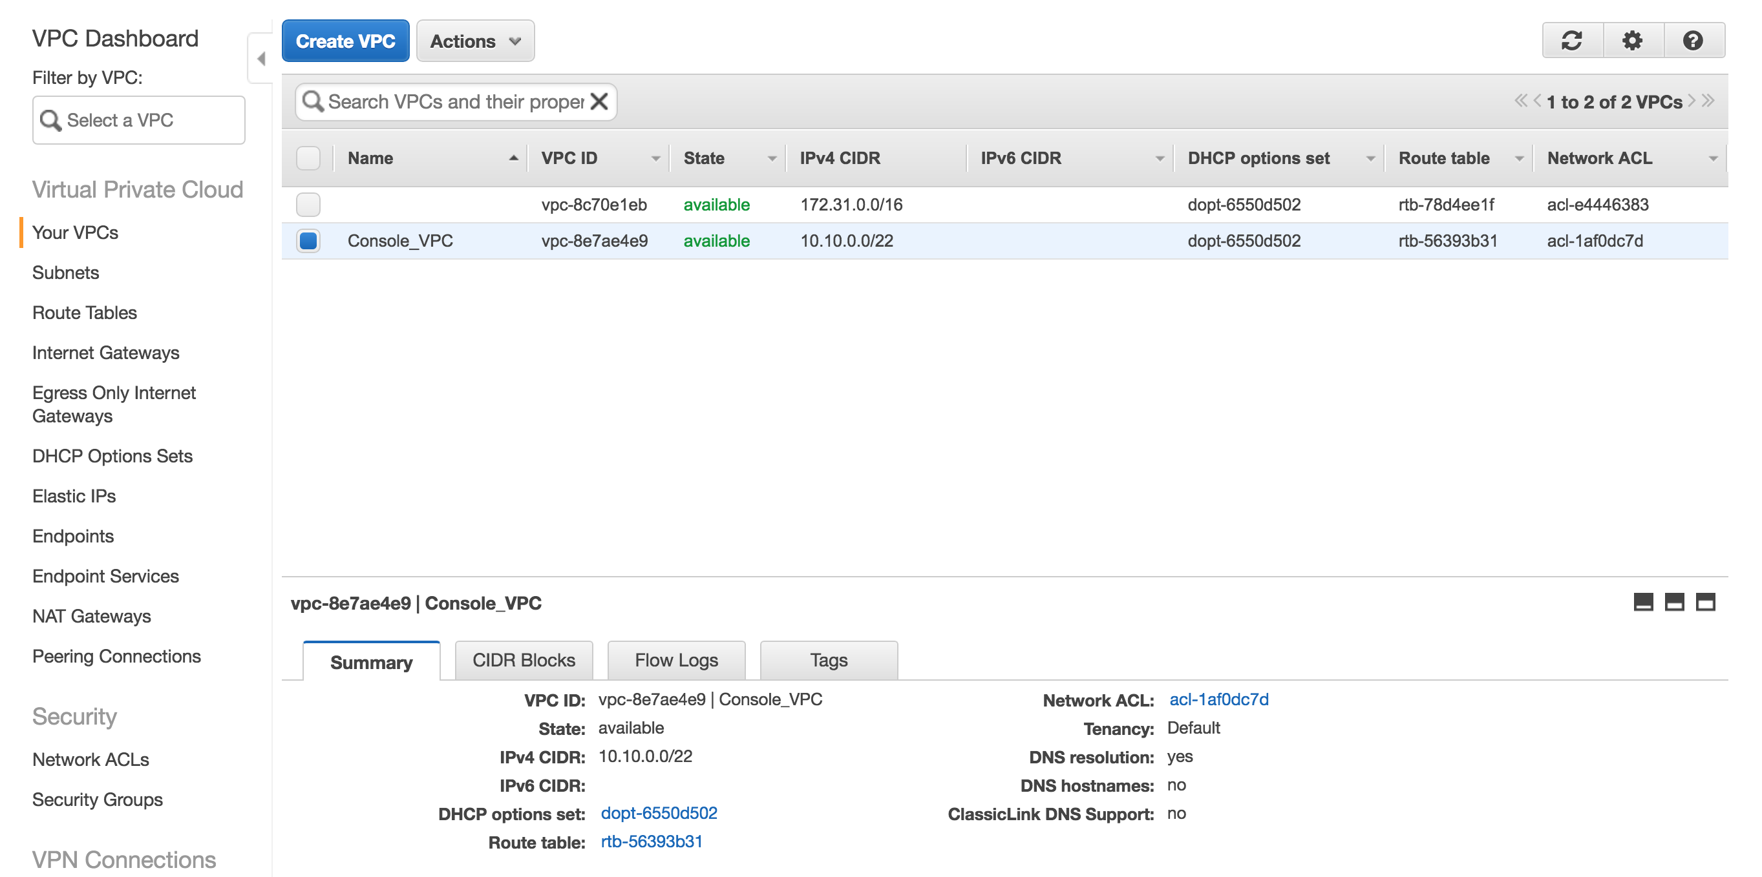
Creating a VPC Cont’d
Notes:
Observe your newly created VPC. Record the VPC ID, as it will be needed to complete subnet, internet gateway and route table configurations.

Slide 19
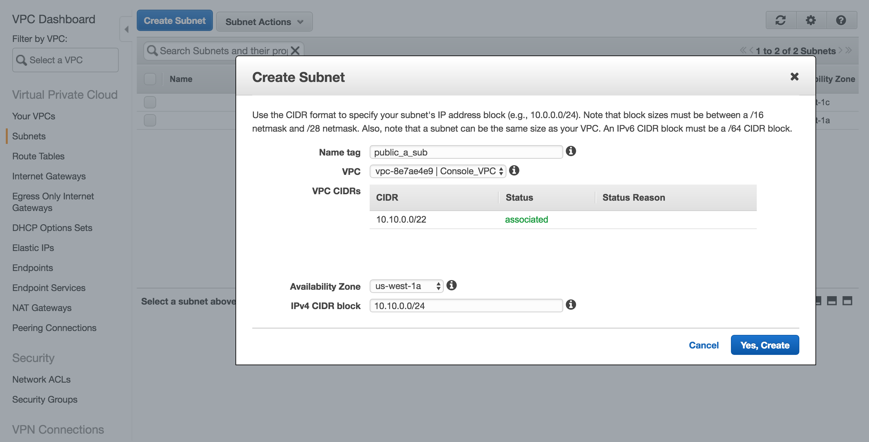
Creating a Subnet
Notes:
From the Subnet dashboard, select ‘Create Subnet’. Within the Create Subnet window, use the below info to configure a Public and click ‘Yes, Create’. Repeat this step for Private Subnet.

Slide 20
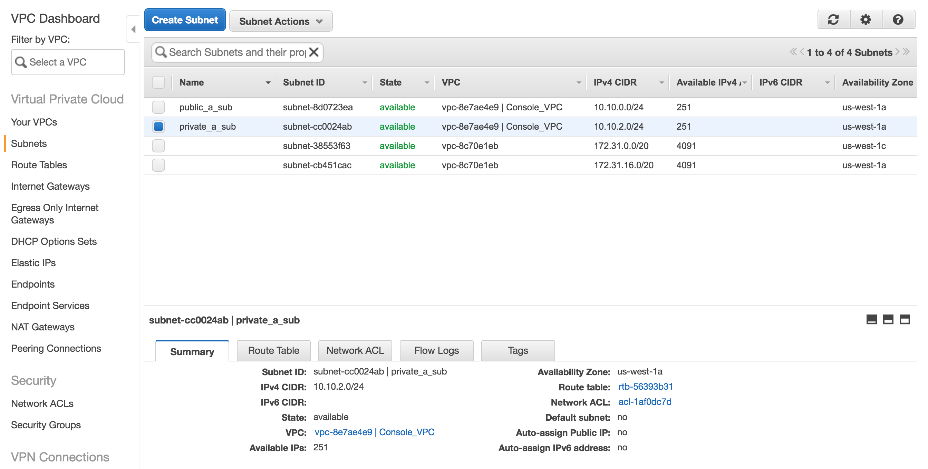
Configured Subnets – Multi Availability Zone

Slide 21
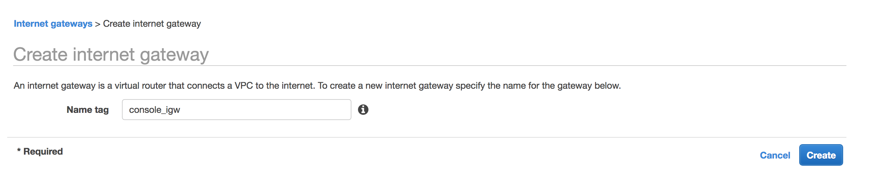
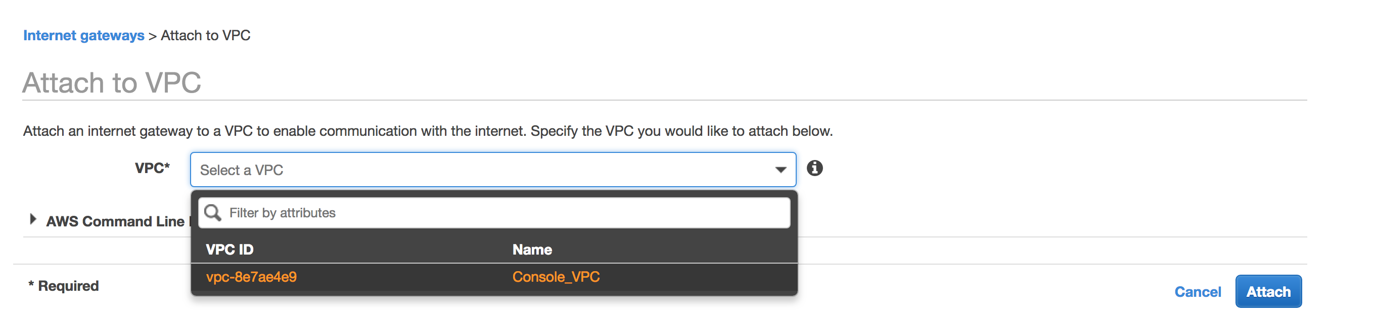
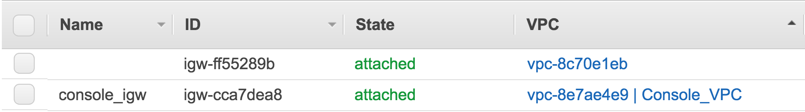
Configuring Internet Gateway

Slide 22
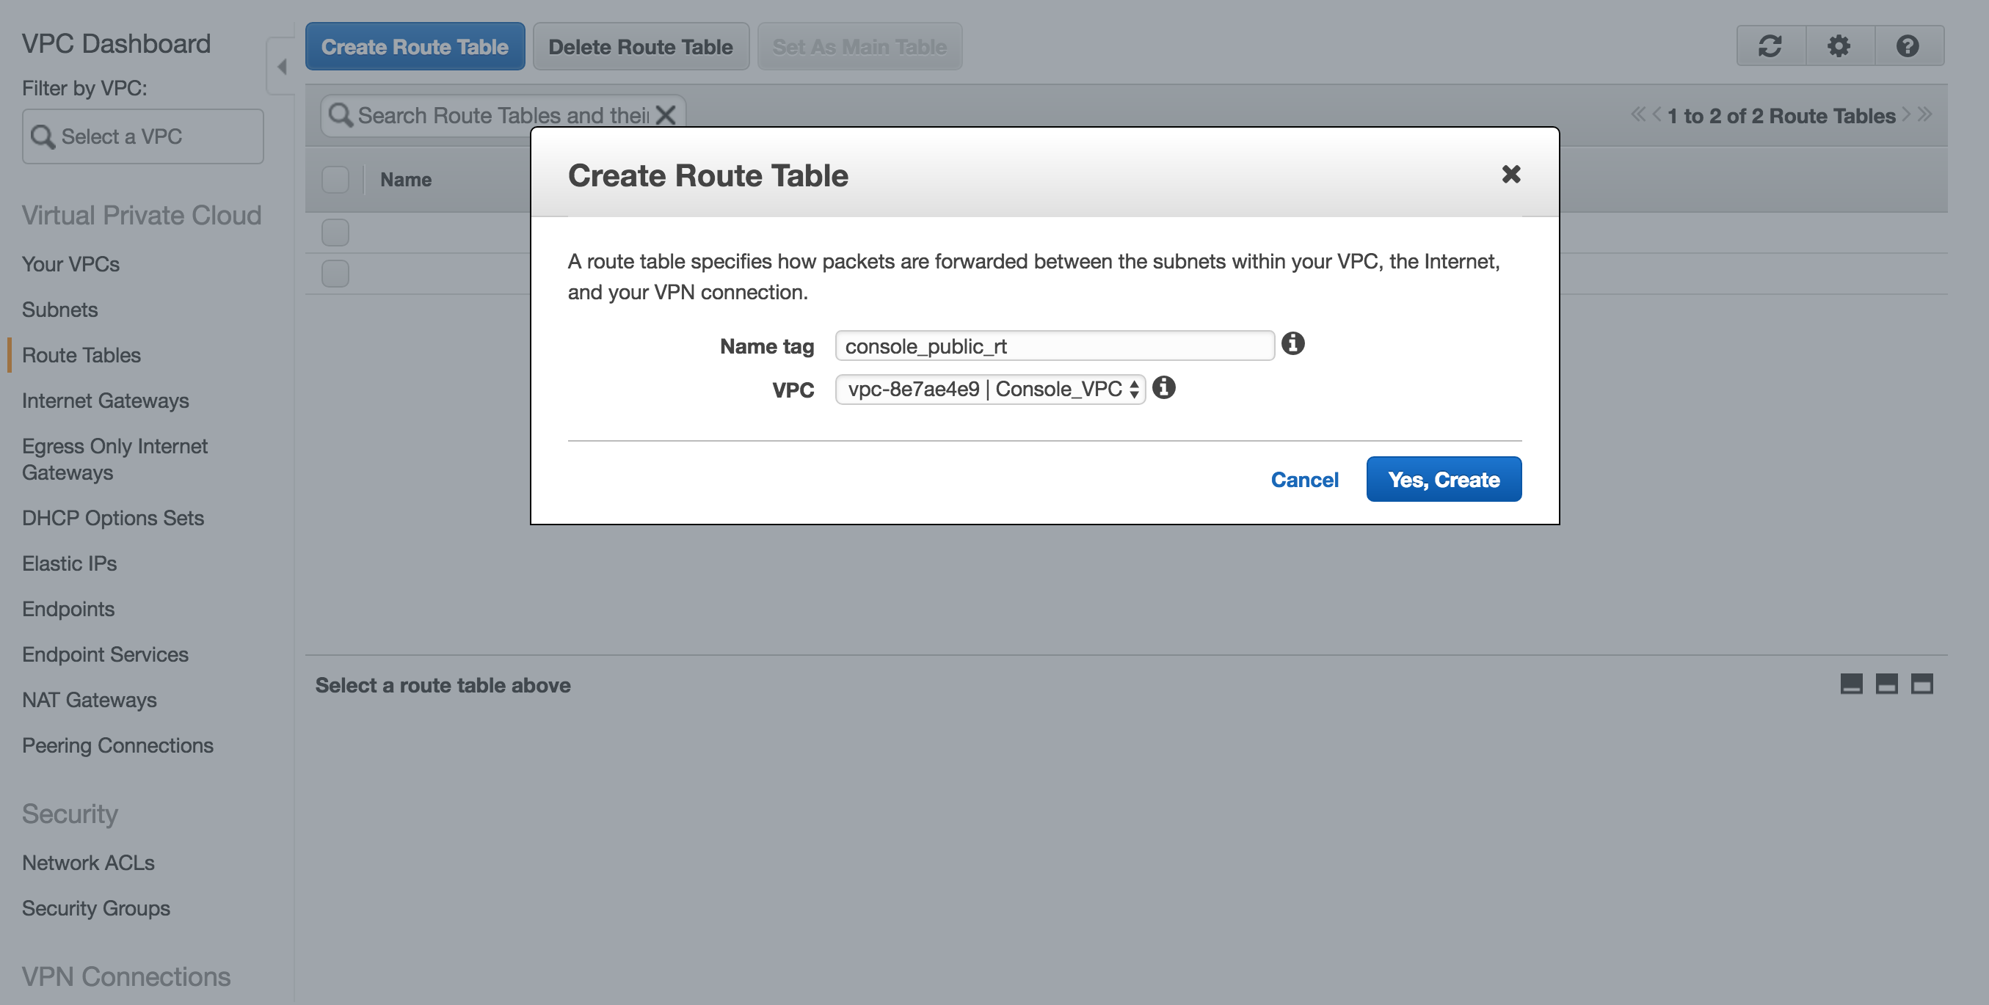
Create Route Table

Slide 23
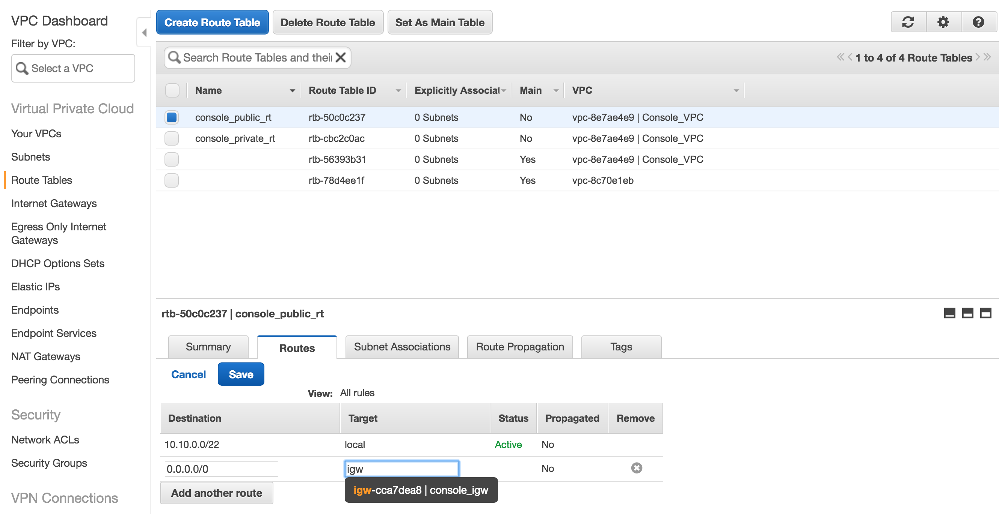
Create Route Table Cont’d

Slide 24
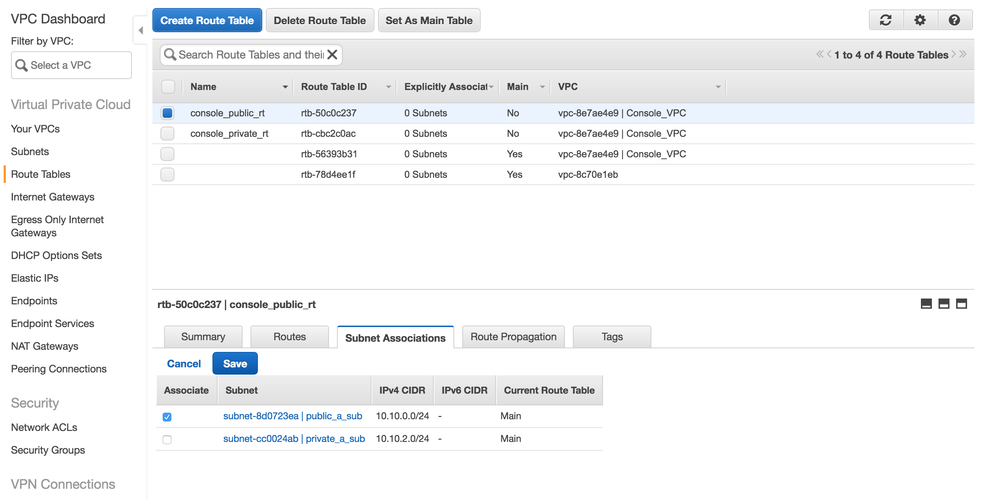
Create Route Table Cont’d

